Slide 1
ONLINE TUTOR APP
REPRESENTED BY-NAME
CLLG NAME:(-)

Slide 2
CONTENTS
INTRODUCTION
Empowering Education Beyond Boundaries
KEY FEATURES
DATA FLOW DIAGRAM
SCREENSHOTS
CONCLUSION

Slide 3
INTRODUCTION
In today's fast-paced world, education transcends the confines of traditional classrooms. With the advent of technology, learning has become more accessible, personalized, and interactive than ever before. One such innovation revolutionizing the educational landscape is the Online Tutoring Application.

Slide 4
Empowering Education Beyond Boundaries
Online Tutoring Applications serve as bridges between students and a world of knowledge, breaking geographical barriers and time constraints. Whether you're a high school student seeking help with algebra, a college student delving into advanced calculus, or an adult learner pursuing a new language, these applications offer tailored learning experiences to suit your individual needs and aspirations.

Slide 5
KEY FEATURES
Personalized Learning: Online tutoring applications understand that every student is unique.
Expert Guidance: Gain access to a global network of expert tutors who are passionate about sharing their knowledge and expertise.
Convenience and Flexibility: Say goodbye to rigid schedules and commuting woes. With online tutoring applications, learning fits into your life, not the other way around.
Interactive Learning Tools: Engage in immersive learning experiences through interactive tools such as virtual whiteboards, multimedia resources, and real-time chat.
Progress Tracking and Feedback:Stay on track with your learning goals through progress tracking and feedback mechanisms.

Slide 6
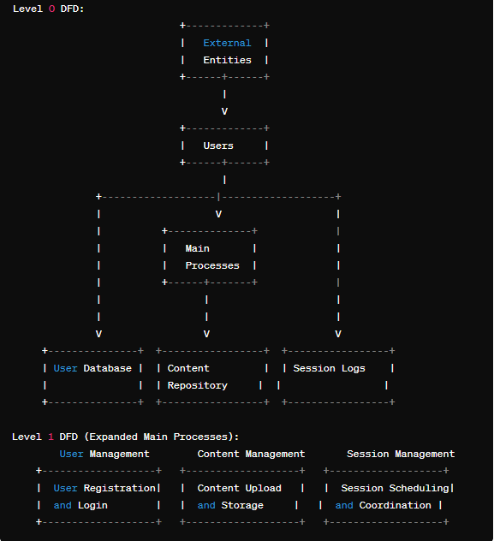
DATA FLOW DIAGRAM

Slide 7
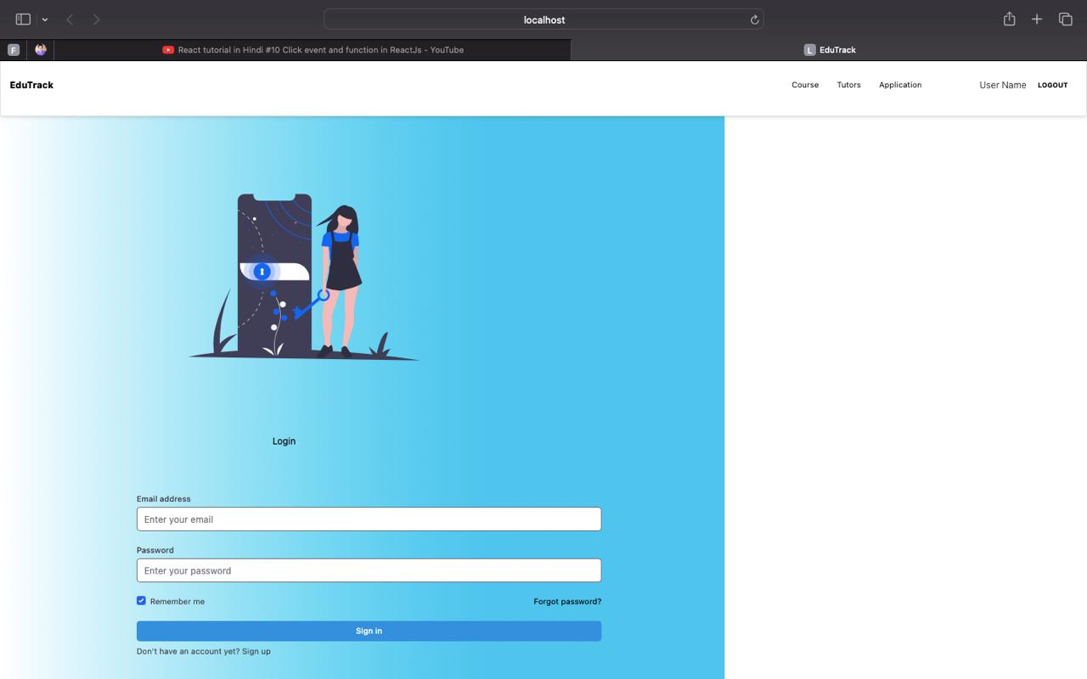
SCREENSHOTS

Slide 8
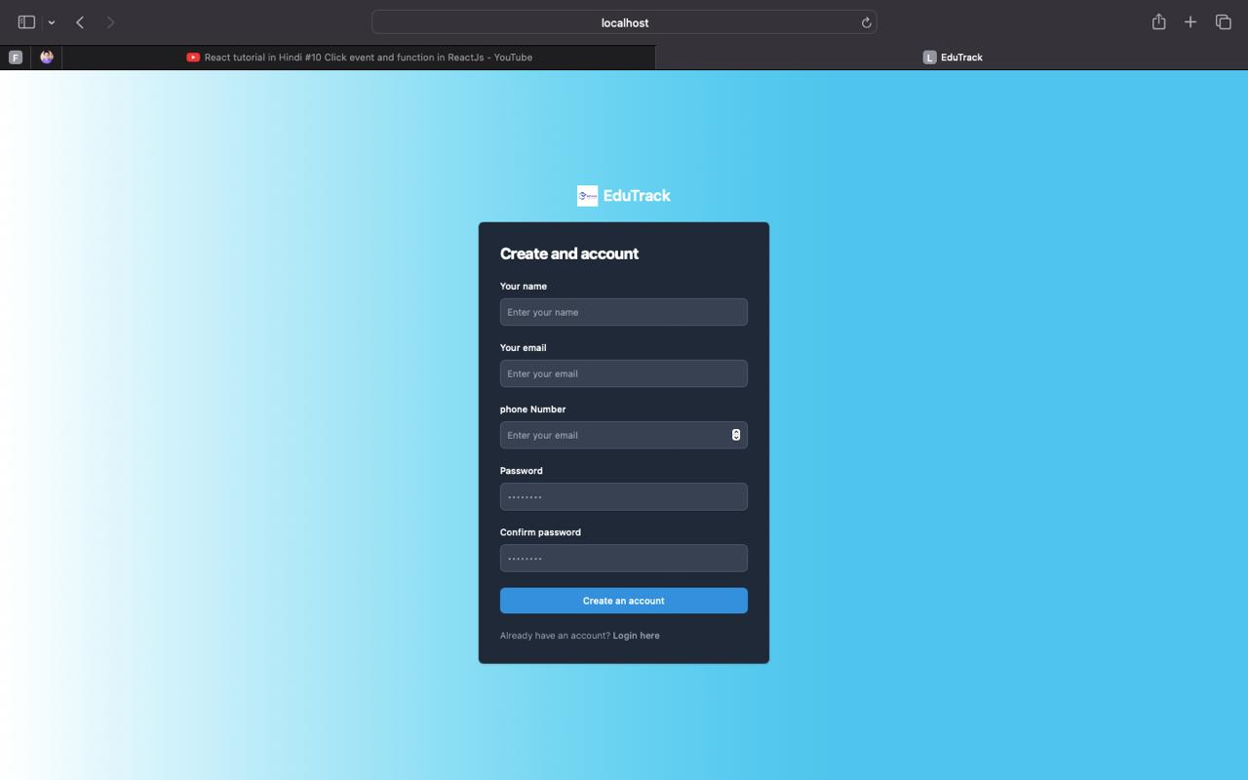

Slide 9
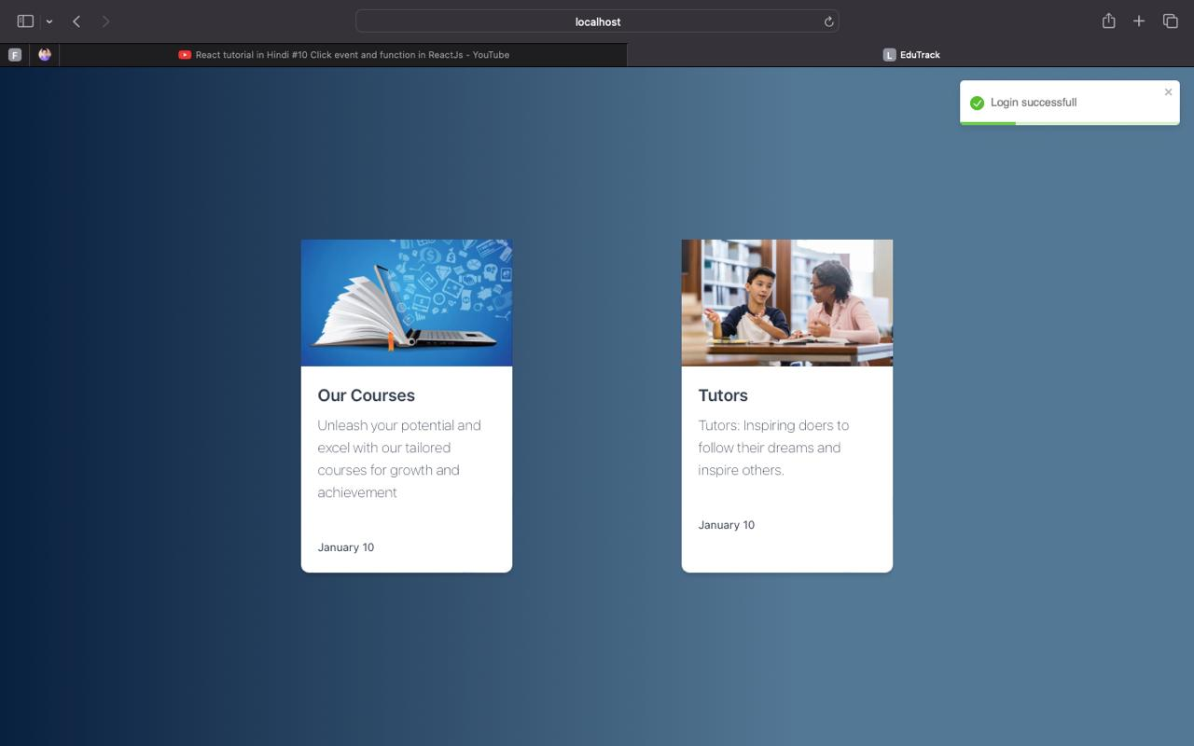

Slide 10
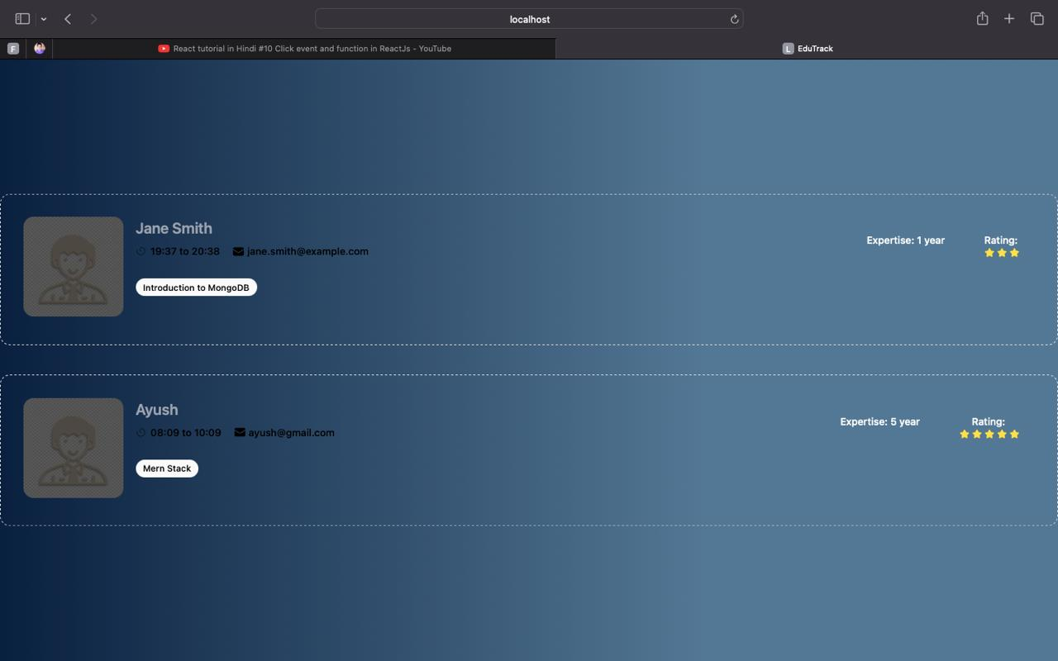

Slide 11
CONCLUSION
In a world where knowledge is power, Online Tutoring Applications empower learners of all ages and backgrounds to unlock their full potential. By providing personalized, accessible, and interactive learning experiences, these applications pave the way for a brighter, more inclusive future of education.

